Slide 1
PRINCIPLES OF MANAGEMENT

Slide 2
UNIT 1 Nature of Management
INSTITUTE OF TECHNOLOGY , NIRMA UNIVERSITY
DR.PARUL BHATI

Slide 3
Definition of Management
Management is the art of getting things done through others.” Follett describes management as an art of directing the activities of other persons for reaching enterprise goals. It also suggests that a manager carries only a directing function.
“Management is the art of directing and inspiring people.” Management not only directs but motivates people in the organization for getting their best for obtaining objectives.

Slide 4
Objectives of Management:
The primary objective of management is to run the enterprise smoothly. The profit earning objective of a business is also to be kept in mind while undertaking various functions.
Following are the broad objectives of management:
1. Proper Utilization of Resources:
2. Improving Performance:
3. Mobilizing Best Talent
4. Planning for Future:

Slide 5
The Nature of Management
The nature Of management. Management is a set of activities (including planning and decision making, organizing, leading, and controlling) directed at an organization's resources (human, financial, physical, and information) with the aim of achieving organizational goals in an efficient and effective manner.

Slide 6
The Nature of Management
Universal Process
Factor of Production
Goal-Oriented
Supreme in Thought and Action
Group Activity
Dynamic Function
Social Science
Important Organ of Society
System of Authority
Profession
Process

Slide 7
Scope of management
Scope of Management. Management deals with clearly defined activities without which progress is not possible. It confines to concepts, principles, theory related to managerial functions.

Slide 8
The following activities are covered under the scope of management:
(i) Planning,
(ii) Organization
(iii) Staffing.
(iv) Directing,
(v) Coordinating, and
(vi) Reporting/Controlling
(VII) Budgeting

Slide 9
The operational aspects of business management, called the branches of management, are as follows:
1. Production Management
2. Marketing Management
3. Financial Management.
4. Personnel Management and
5. Office Management.

Slide 10
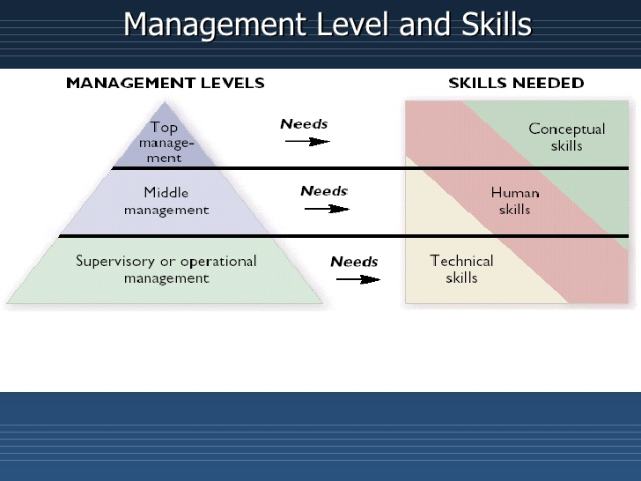
Level of Management

Slide 11
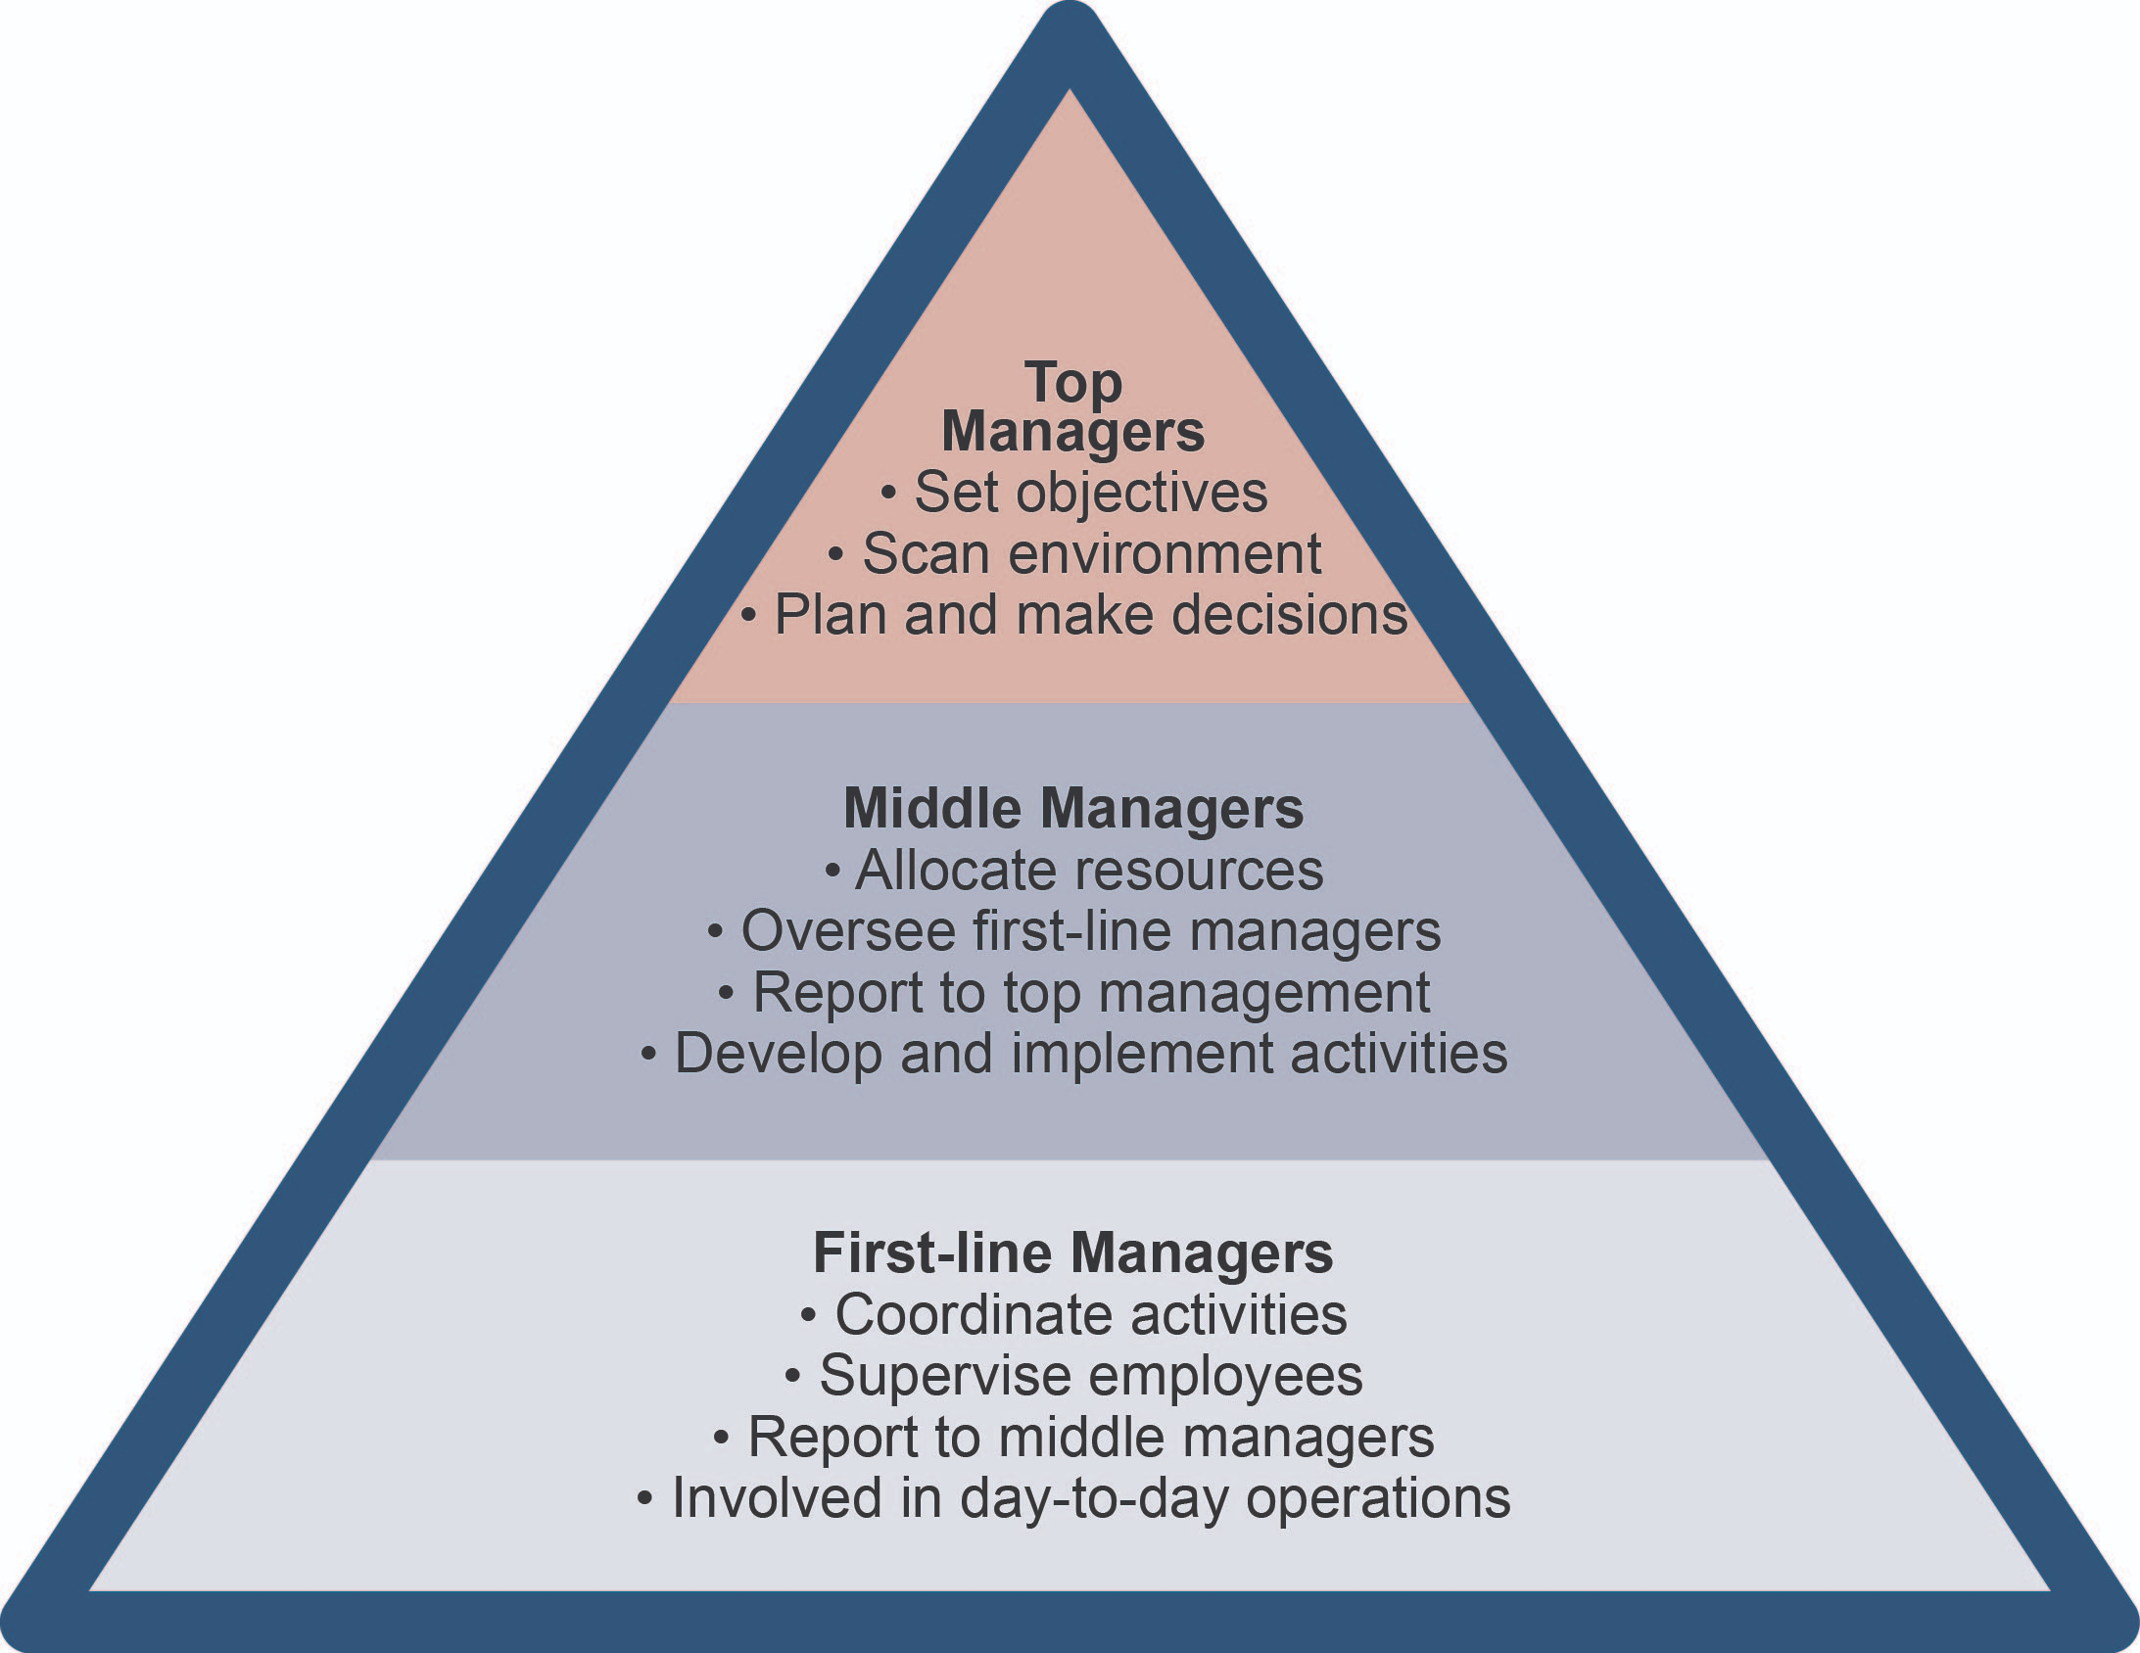
Level of Management

Slide 12
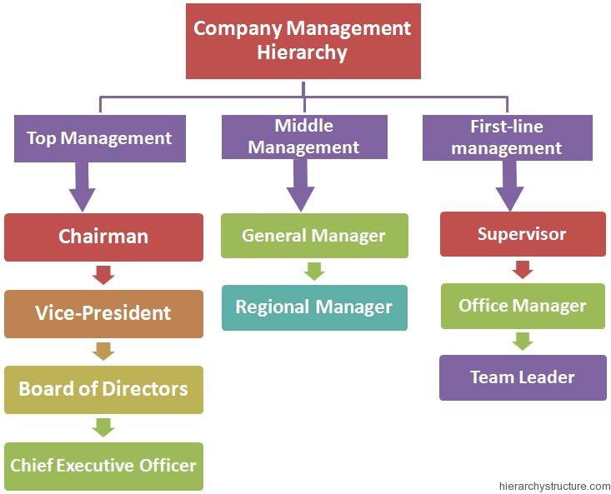
e.g.

